Slide 1
Customer Segmentation
Using K-means Clustering to find target customers for a new product launch

Slide 2
Objective of the Project
2 datasets: Transactions, Customer details
Answer the following questions:
Which merchant category to focus on for launching a new product?
Identifying and describing the various customer segments from the data.
Which specific customer segment would be targeted for launch of the new product?

Slide 3
Methodology
Cleaned the dataset in R
To find the merchant category:
How many unit of products are sold in each category?
How much revenue is each category generating?
To find customer segments
Relation between their relationship status, work status, gender and age according to the merchant category
K-means clustering to segregate the customers based on Recency, Frequency and Monetary values.

Slide 4
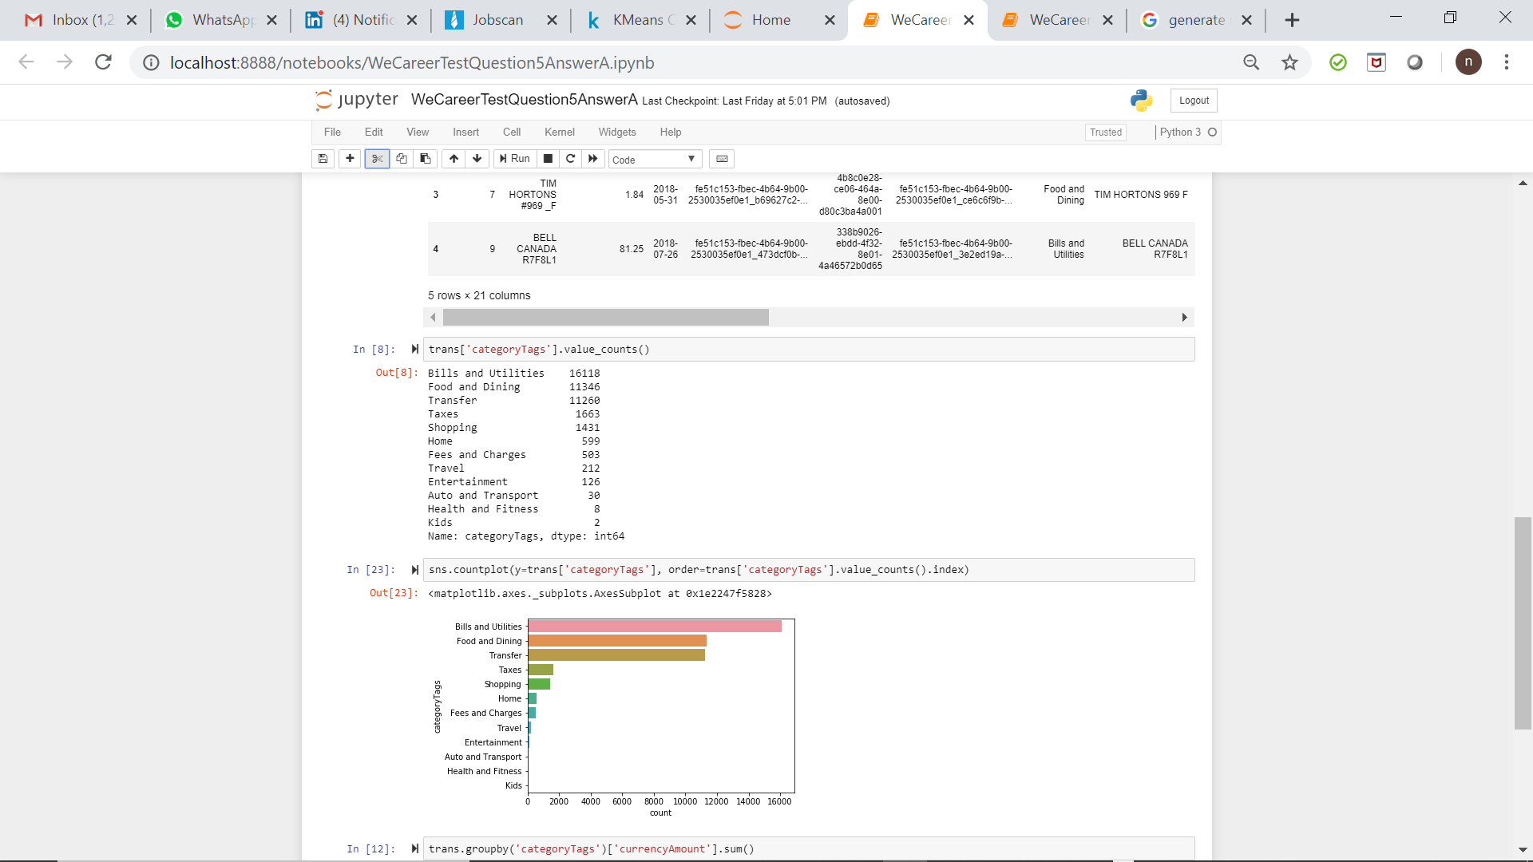
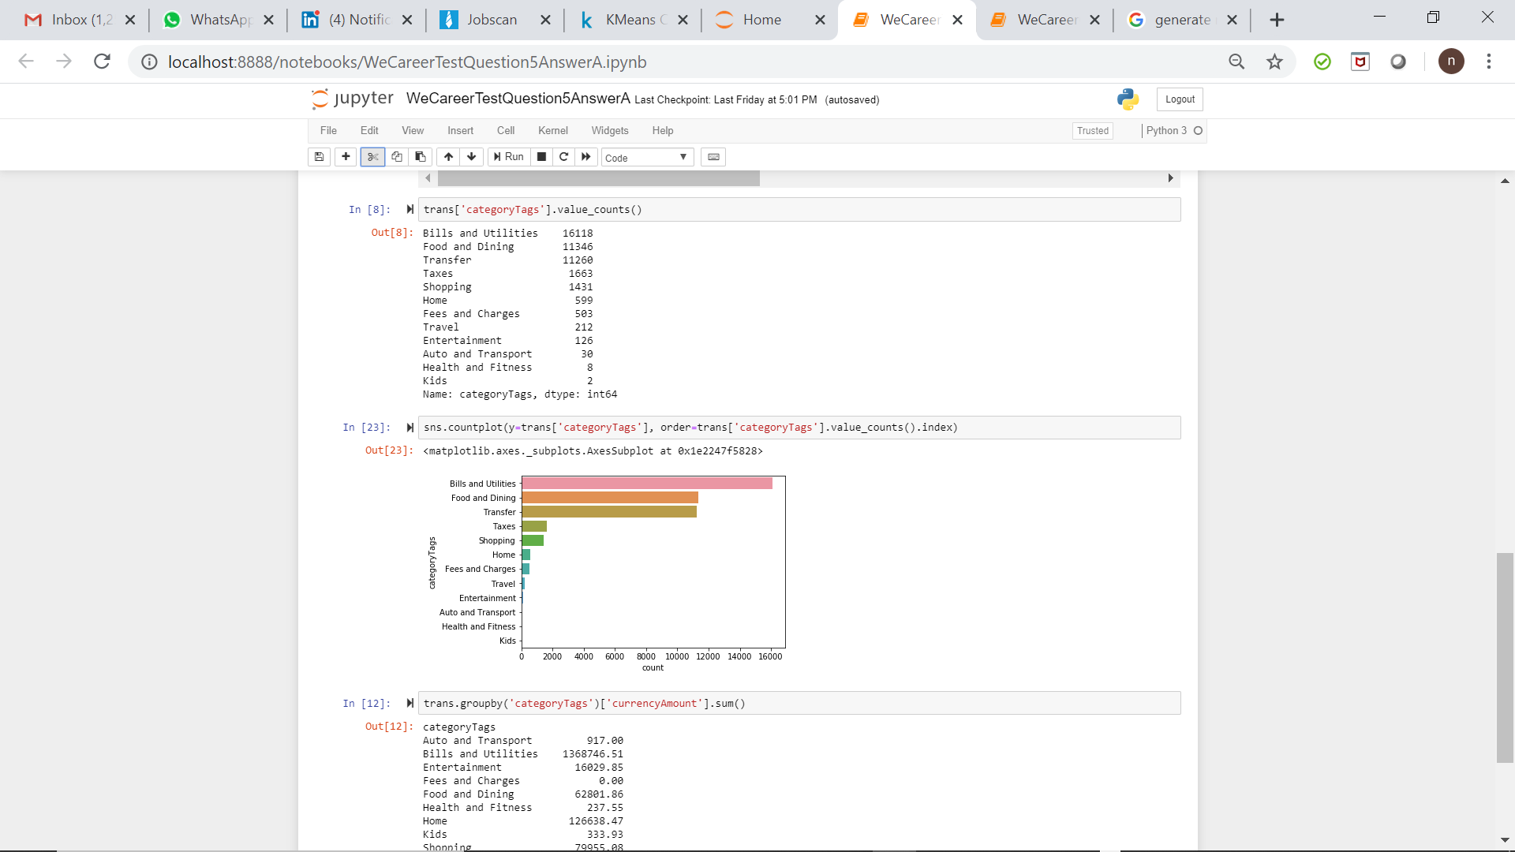
How many unit of products are sold in each category?

Slide 5
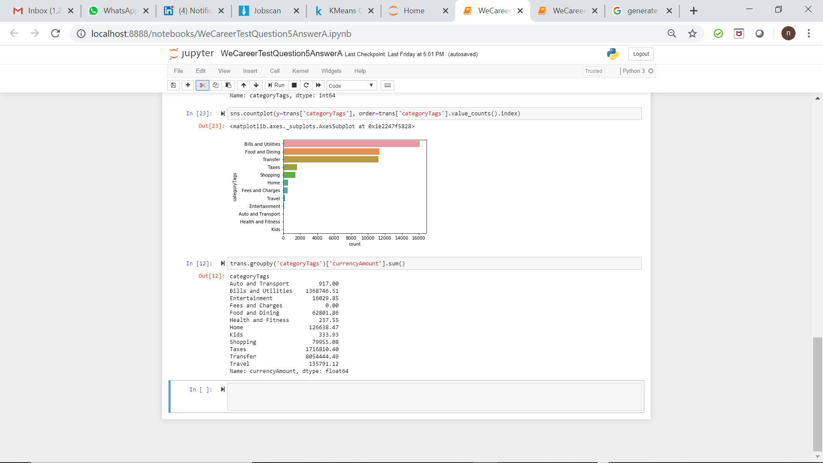
How much revenue is each Category generating?

Slide 6
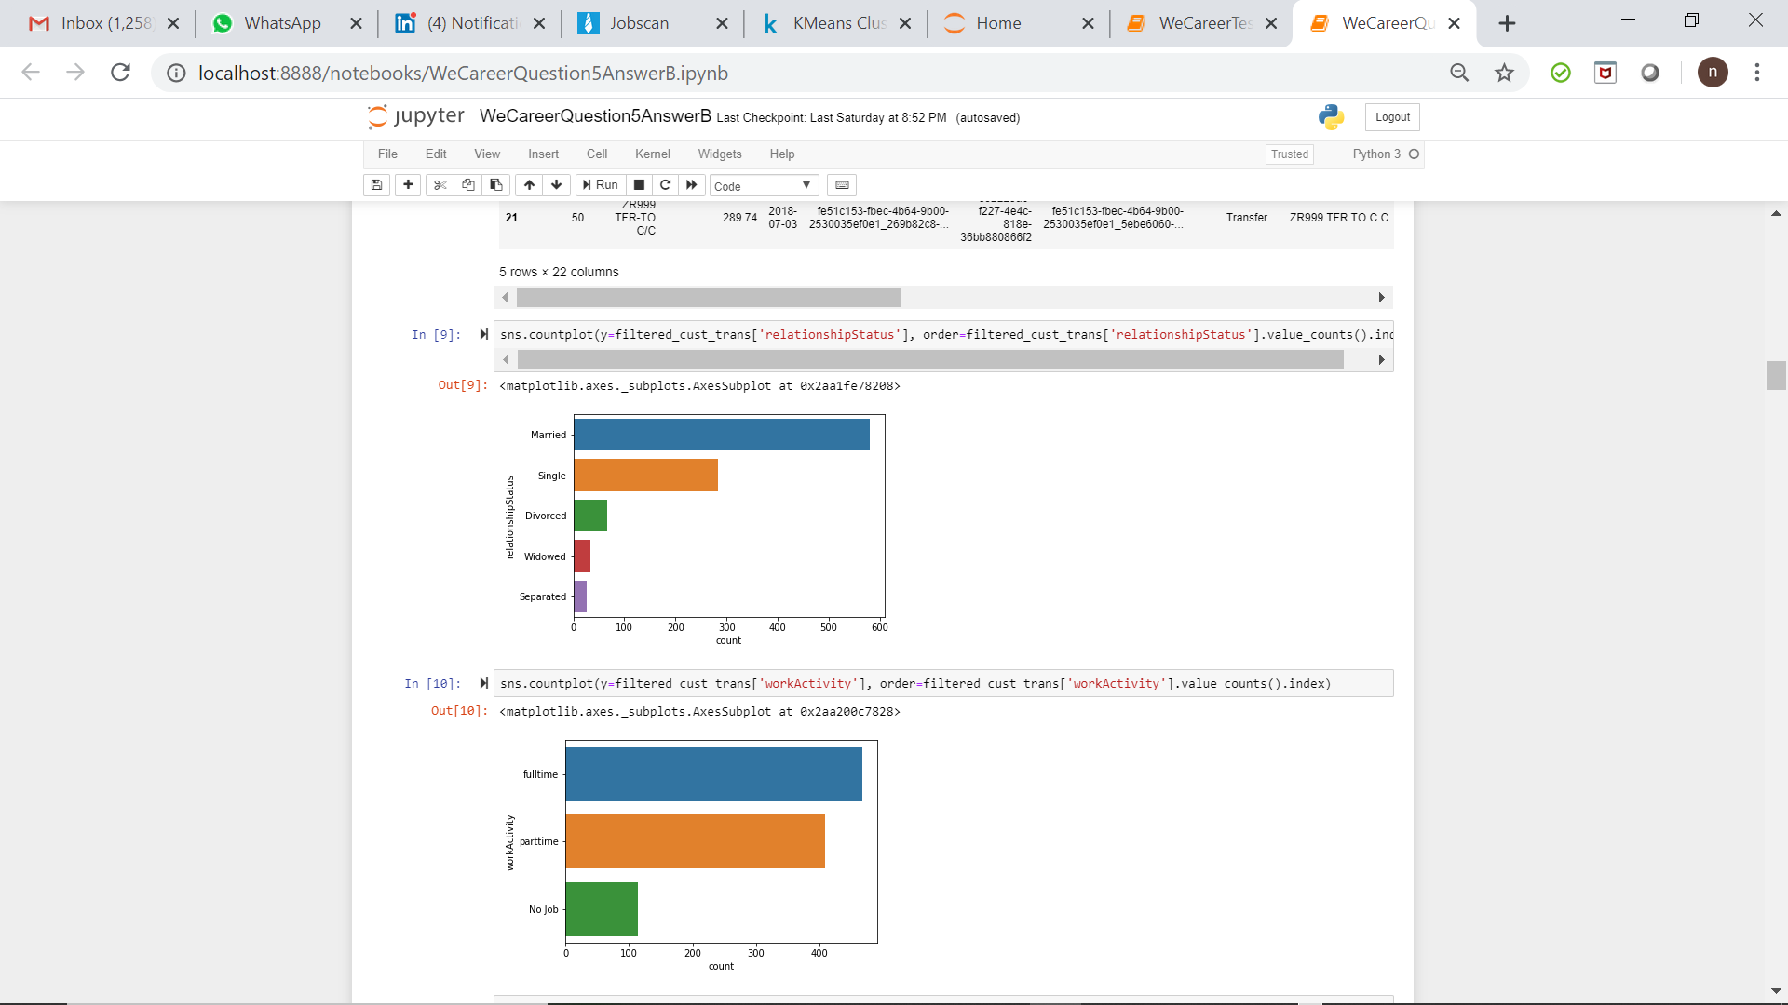
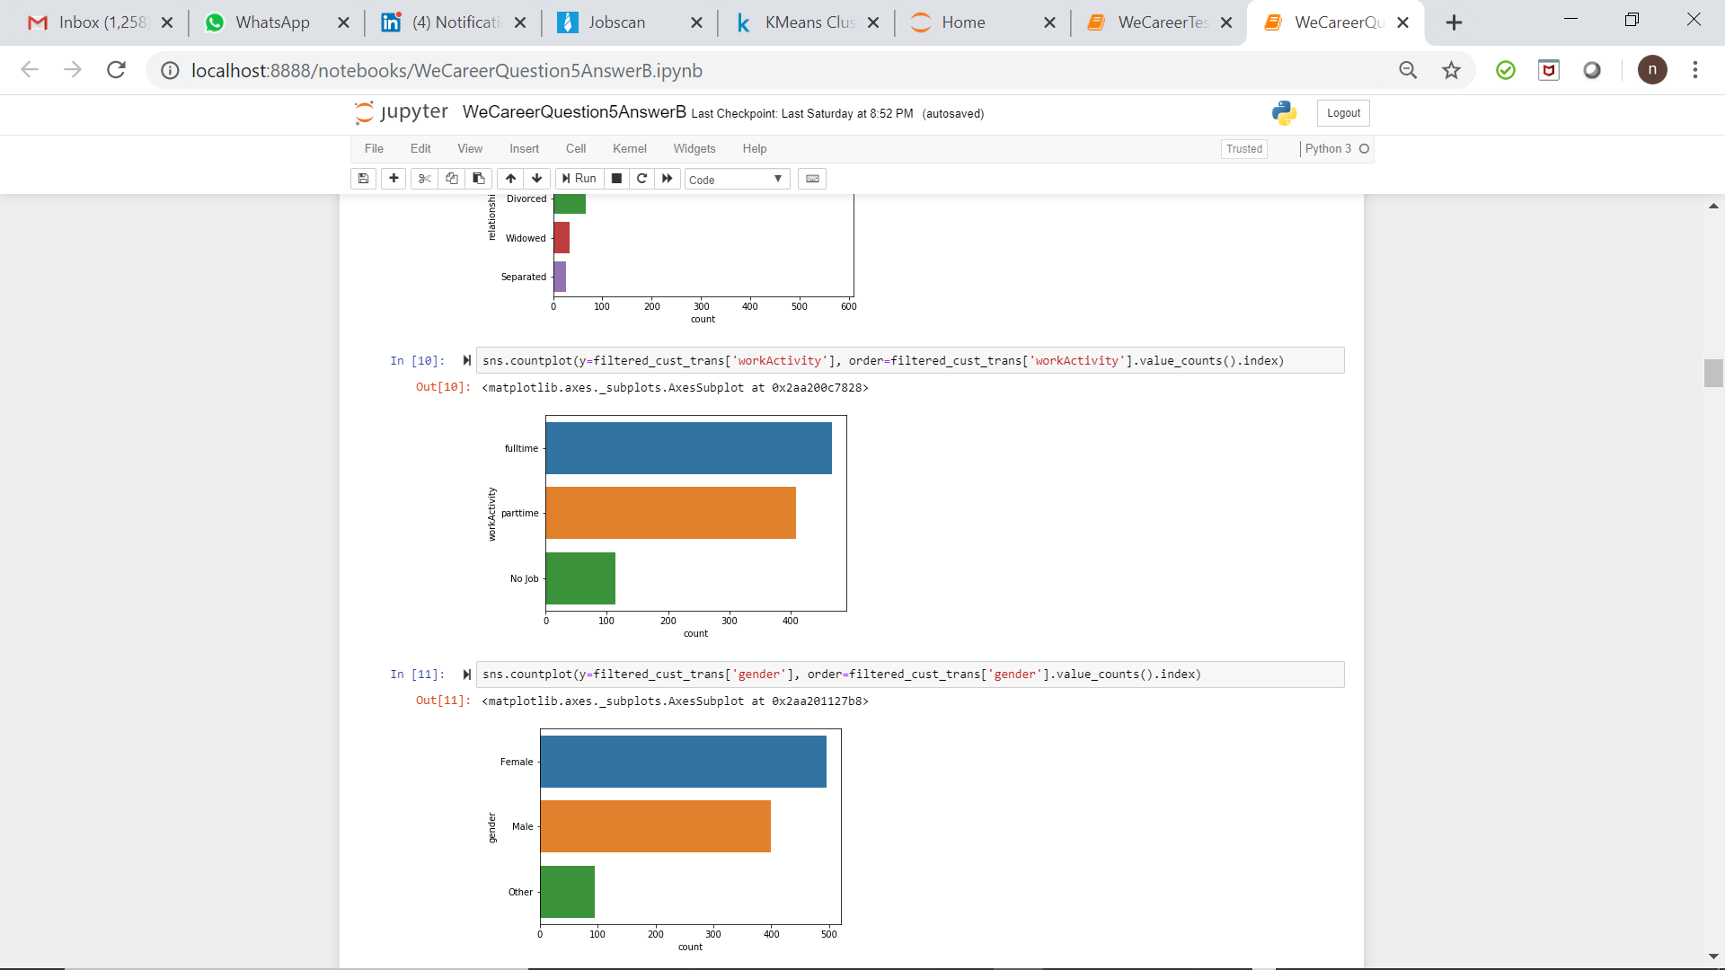
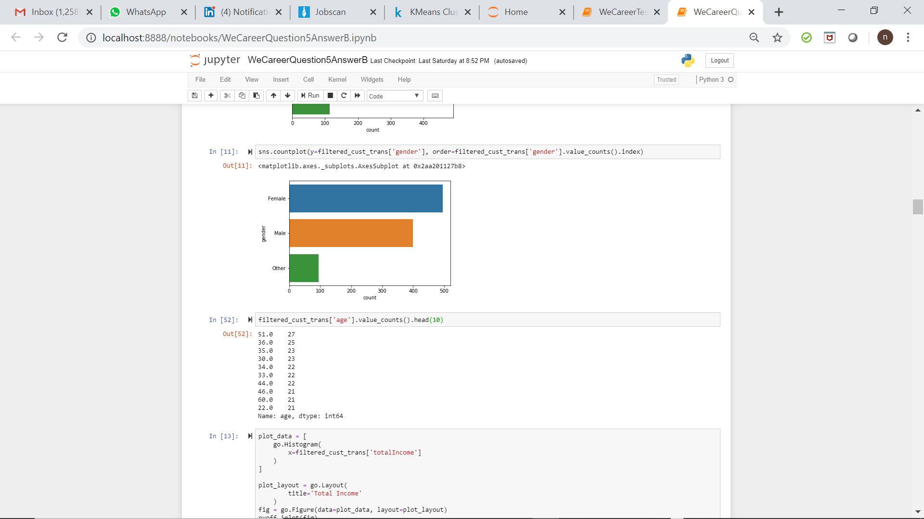
Which specific customer segment would be targeted for launch of the new product?

Slide 7
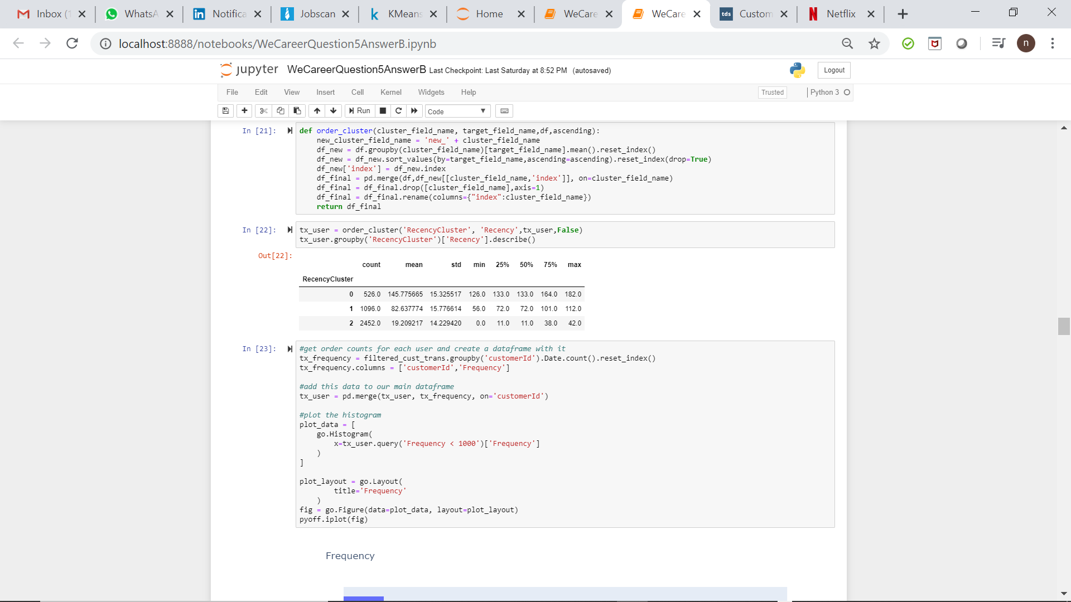
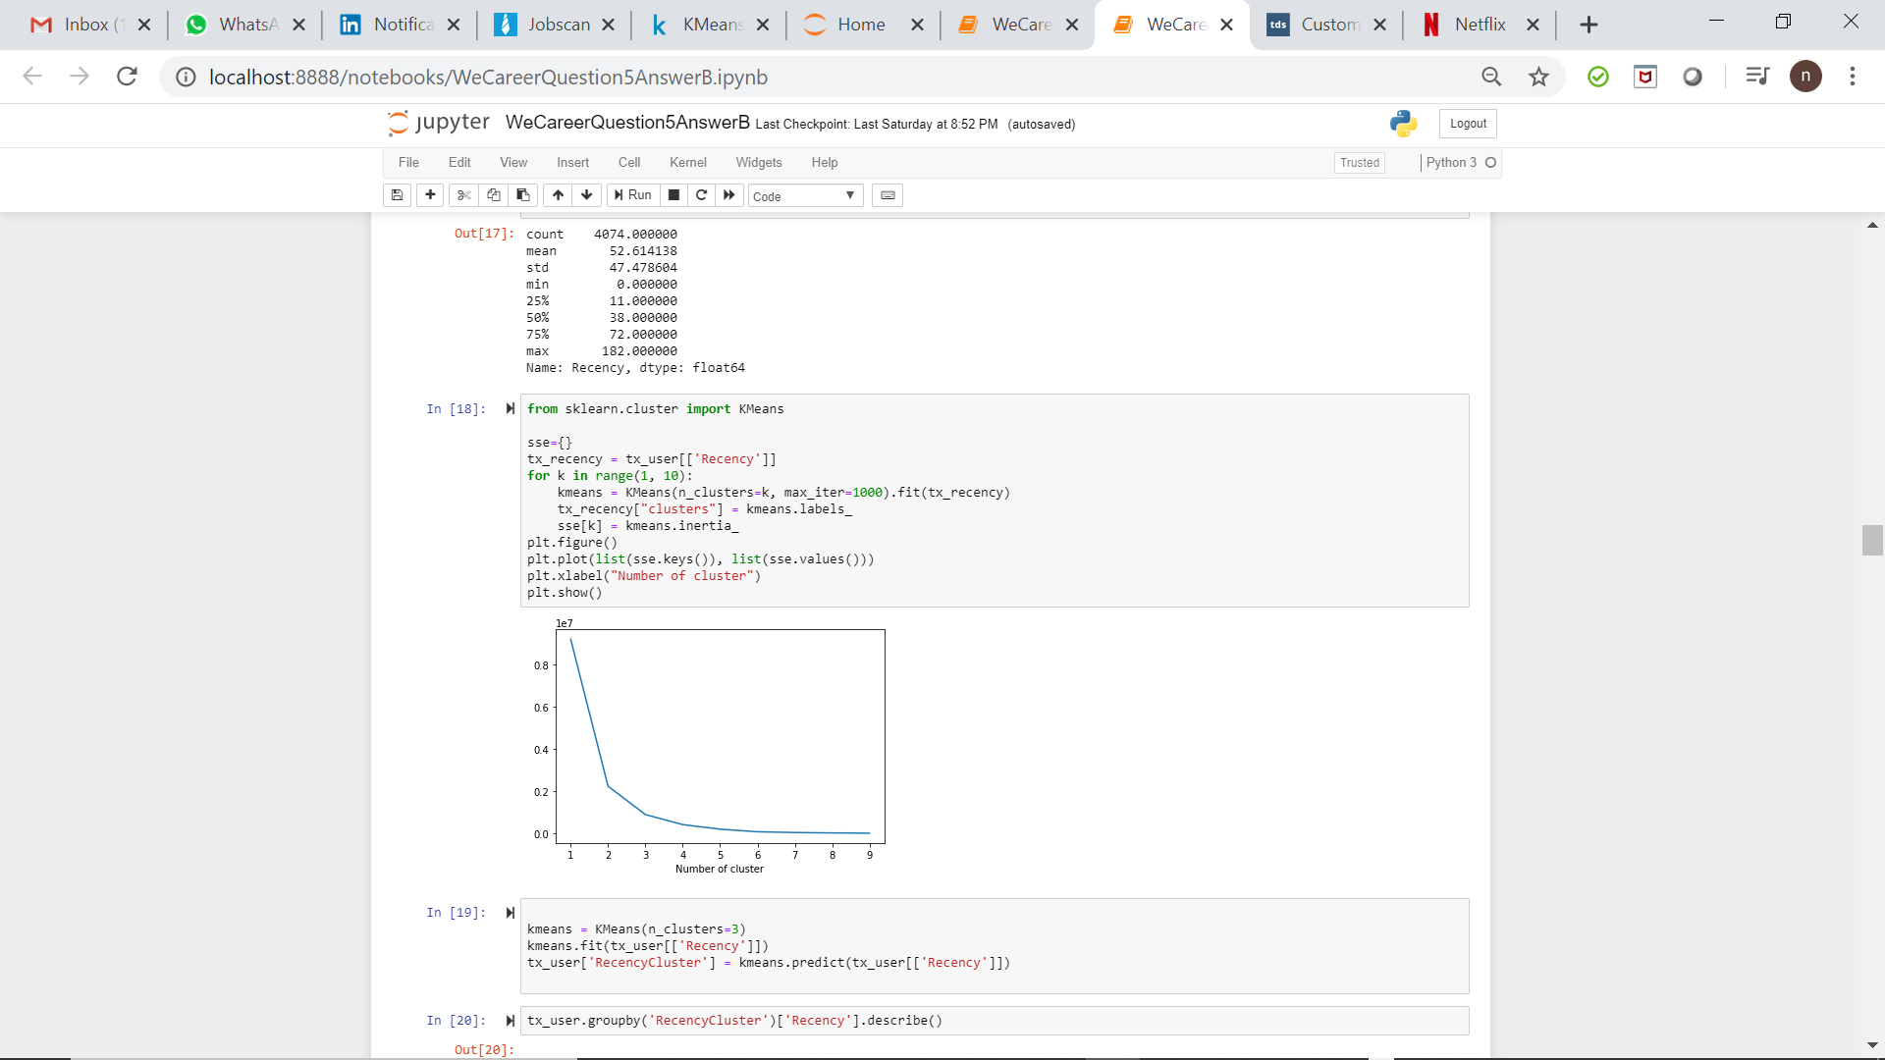
Recency Cluster

Slide 8
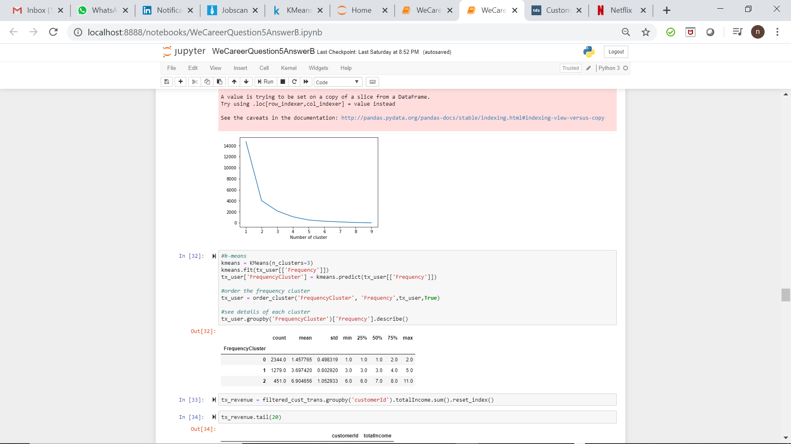
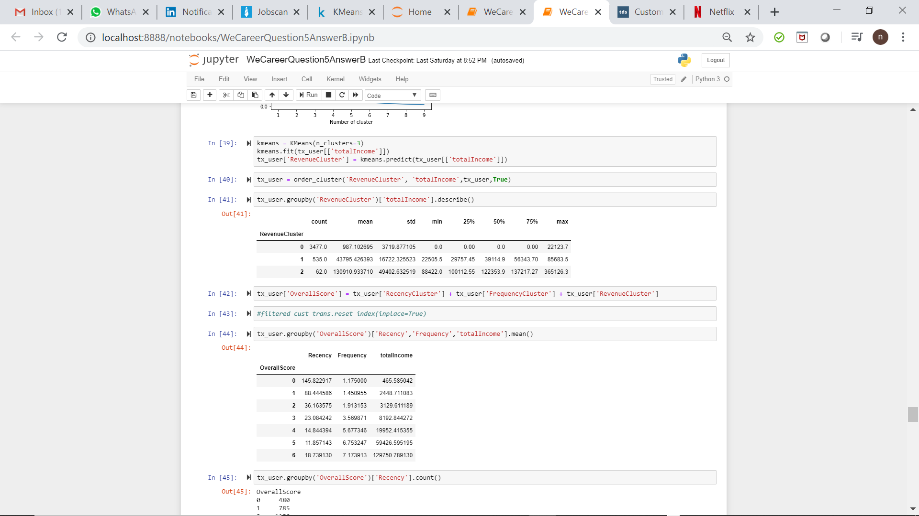
Frequency and Monetary Cluster

Slide 9
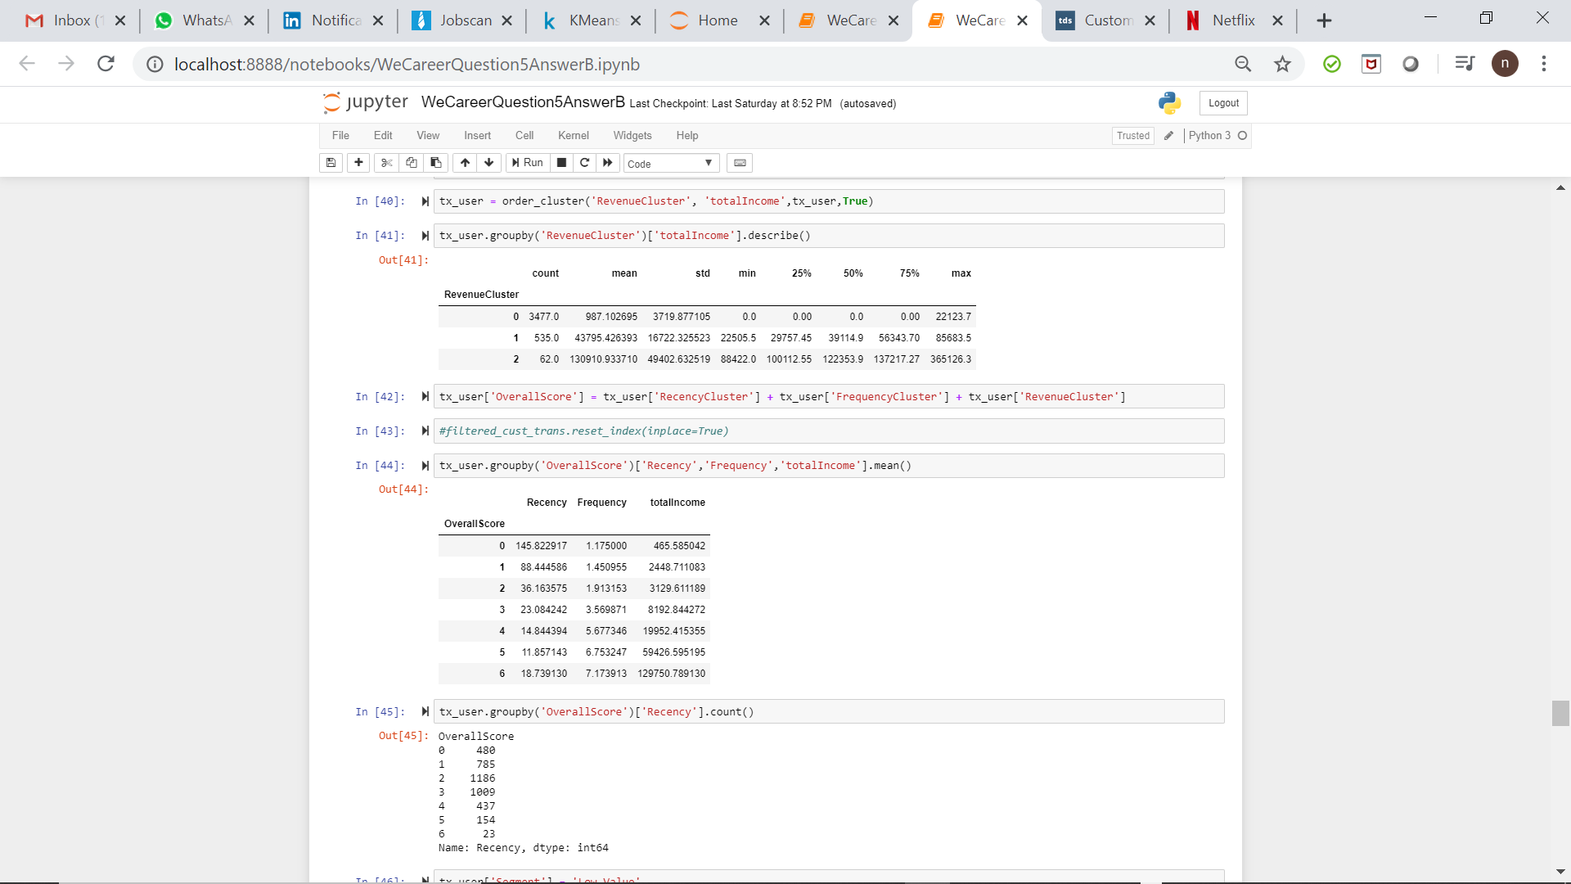
Aggregated Score for RFM

Slide 10
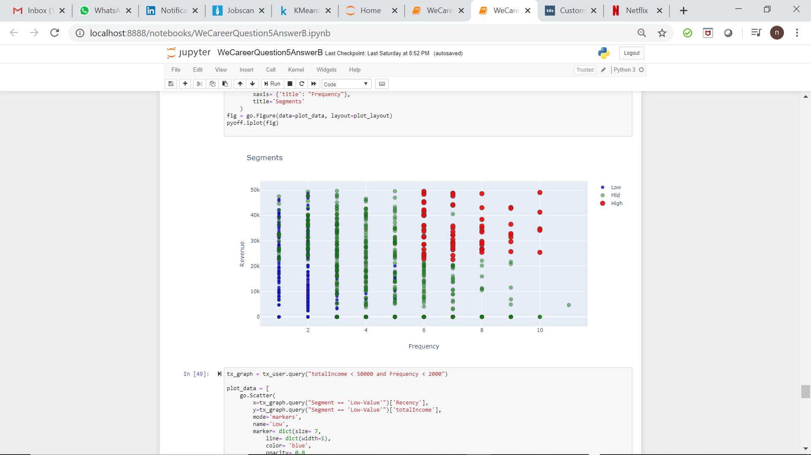
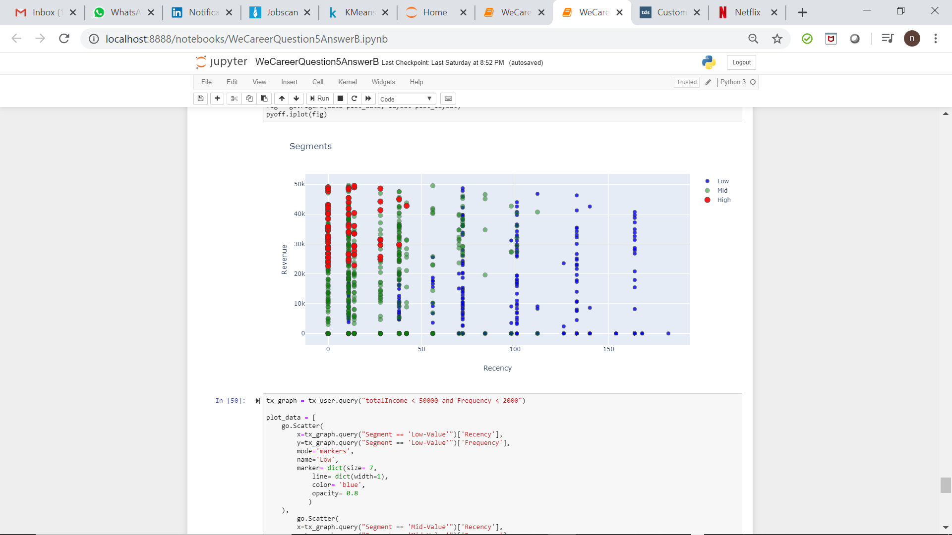
Customer Segmentation Graphs

Slide 11
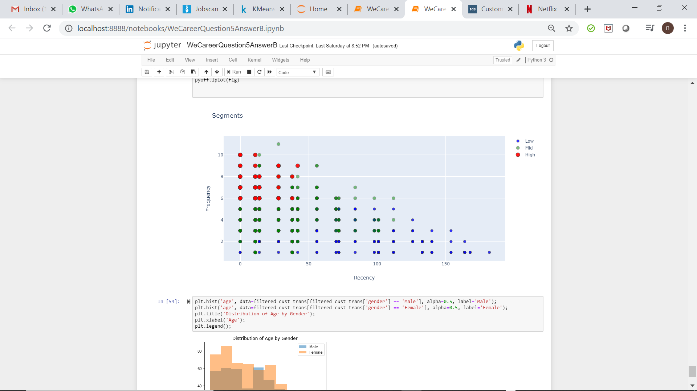
Customer Segmentation Graphs

Slide 12
Result and Conclusion
Launching a product in the transfer category (Credit/Debit Card) will generate maximum revenue
Target customers who are married, working full-time, females and between the age of 30 to 50.
Our high value customers would be customers generating high revenue, are very active (maximum frequency) and very low inactivity.

Slide 13
Possible Marketing Strategies
High Value Customers (Low Recency, High Frequency and High Monetary): Promotional efforts to engage the high value customers
Medium Value Customers (Low Recency, Moderate Frequency, Moderate Monetary): Further analysis could produce insights for the reason for these customers spending less in spite of low recency.
Low Value Customers (High Recency, Low, Frequency, Low Monetary): Find reasons for lower spending of money and analyse the customer feedback for the products to evolve strategies accordingly. Price sensitive strategies could be implemented accordingly.

